Slide 1
Graph Neural Networks
Slides adapted from Jure Leskovec’s CS224W lecture on Machine Learning on Graphs

Slide 2
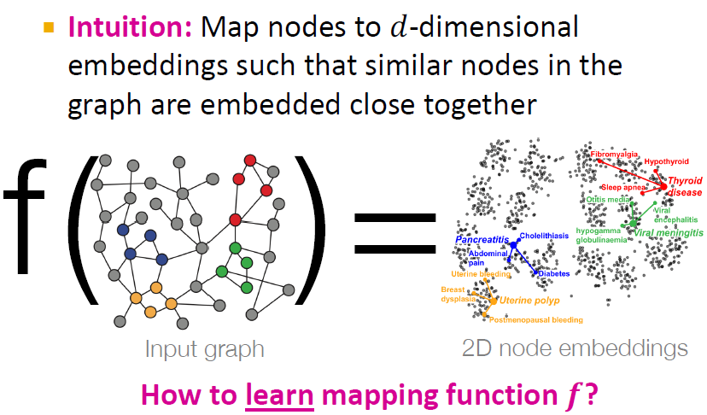
Recap – Node Embeddings

Slide 3
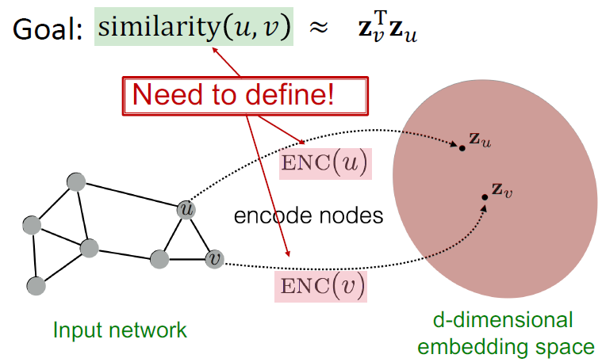
Recap – Node Embeddings

Slide 4
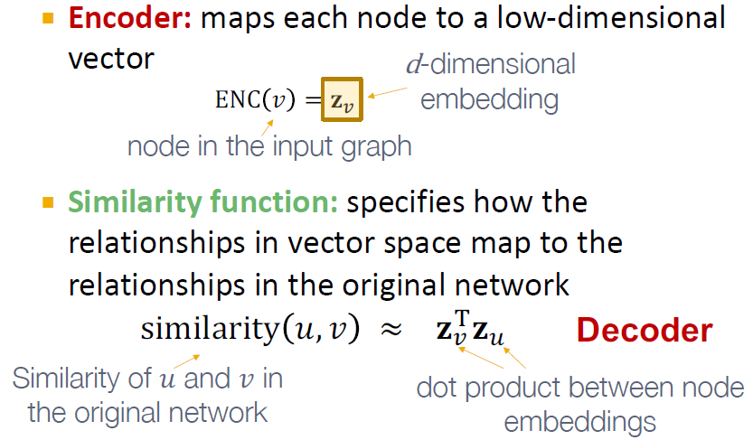
Recap – Node Embeddings

Slide 5
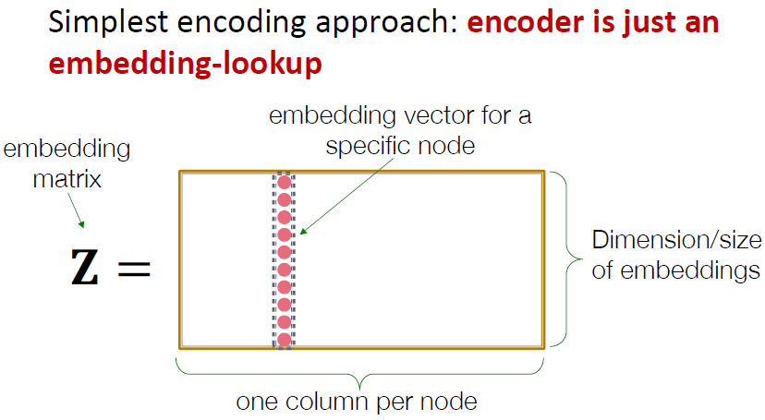
Recap – Shallow Encoding

Slide 6
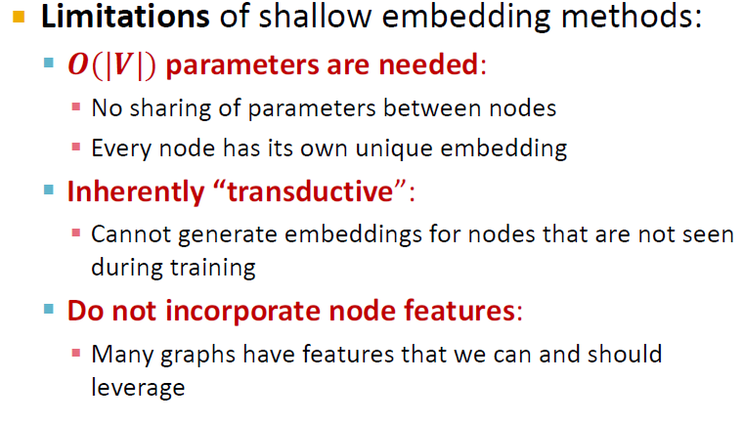
Recap – Shallow Encoders

Slide 7
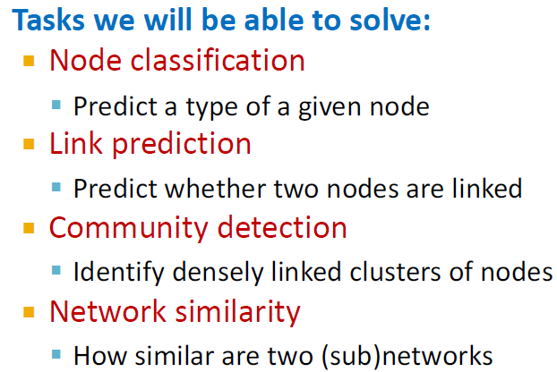
Tasks on Networks

Slide 8
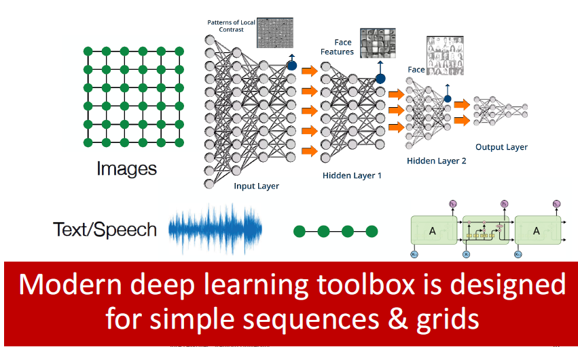
Modern ML Toolbox

Slide 9
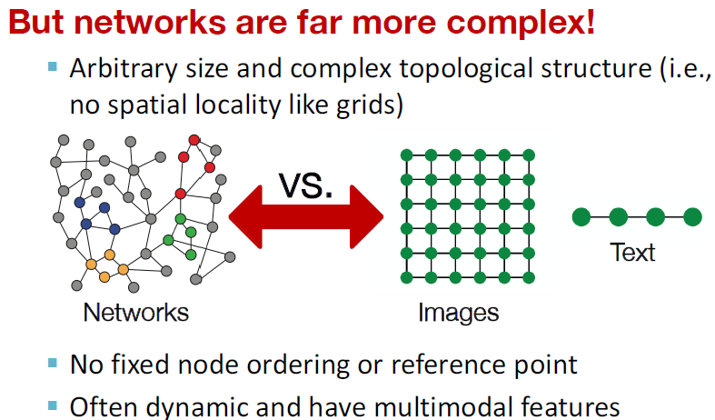
Why deep learning on Graphs is hard?

Slide 10
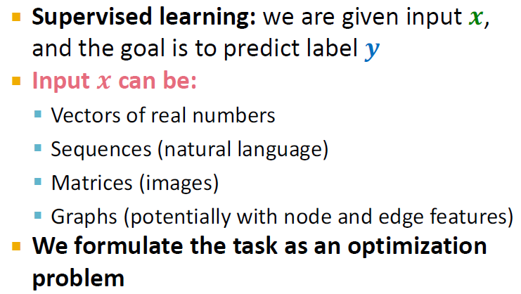
Machine Learning as Optimization

Slide 11
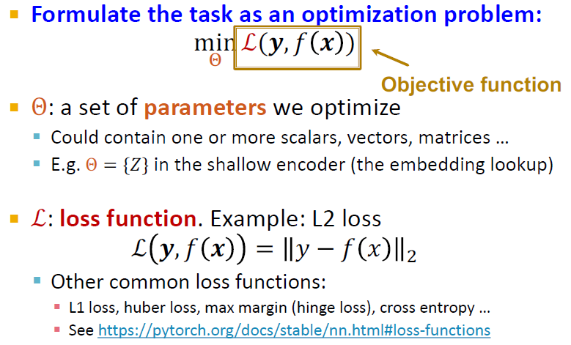
Machine Learning as Optimization

Slide 12
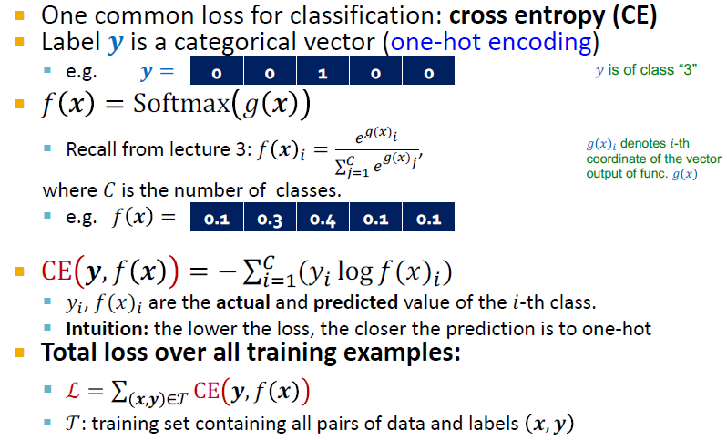
Loss function example

Slide 13
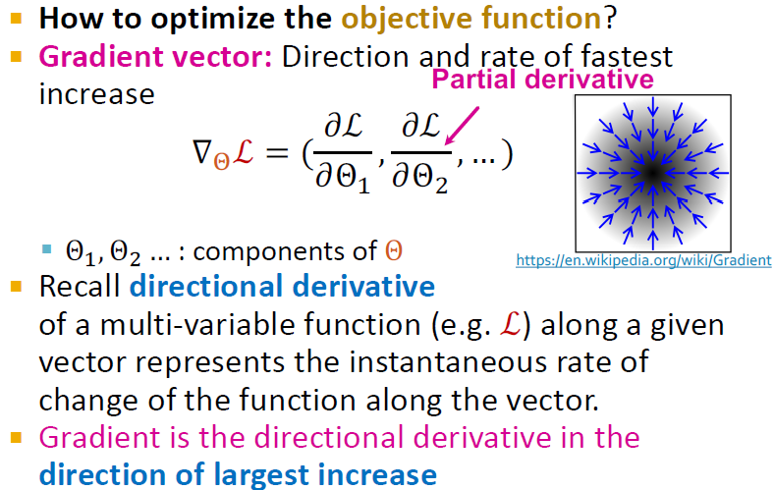
Machine Learning as Optimization

Slide 14
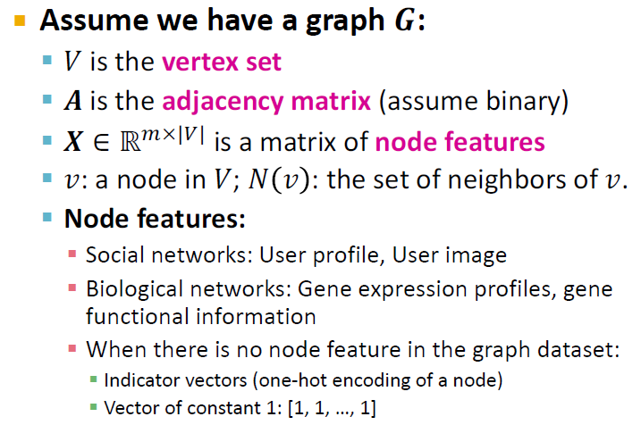
Setup

Slide 15
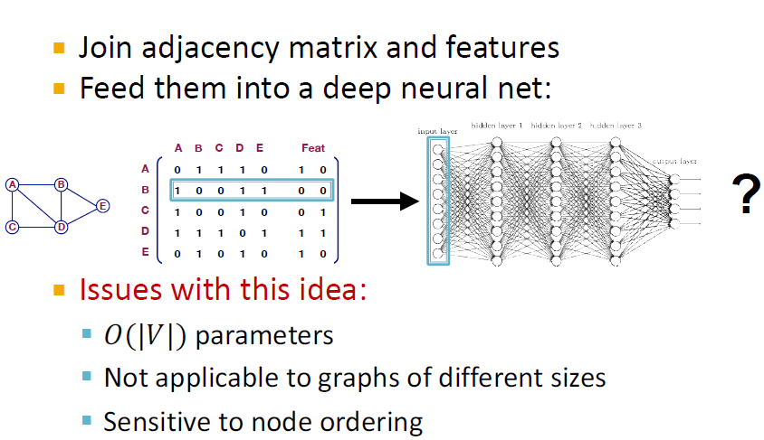
Naïve Approach

Slide 16
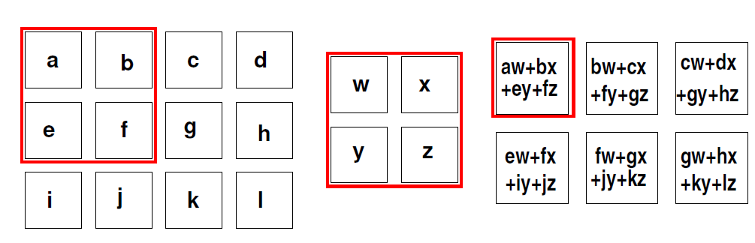
Idea – Use Convolution Networks

Slide 17

Idea – Use Convolution Neural Networks
Goal is to generalize convolutions beyond simple lattices
Leverage node feature attributes (texts and Images)

Slide 18
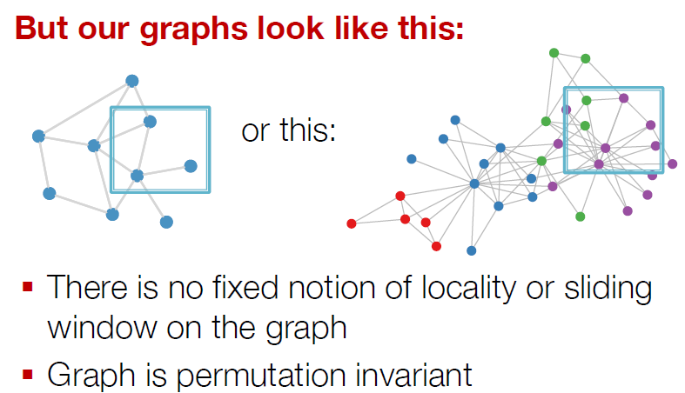
Real World Graphs

Slide 19
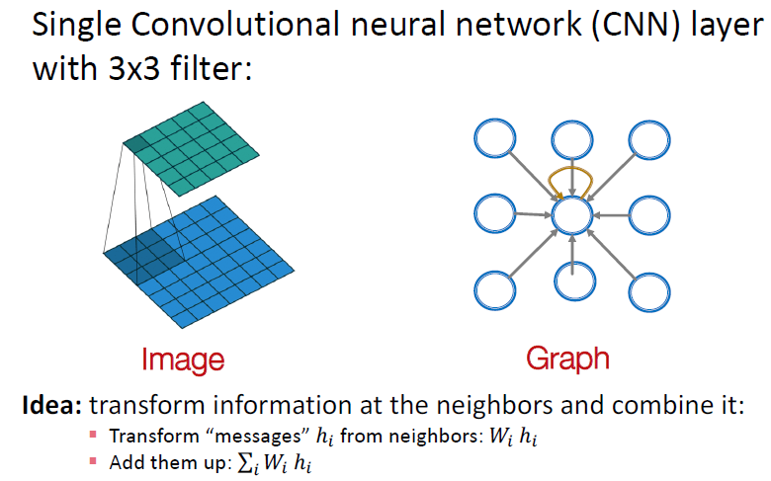
Applying CNNs for graphs

Slide 20
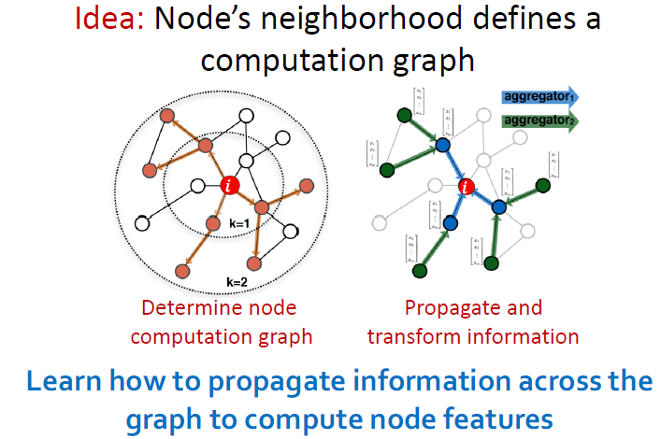
Graph Convolution Networks

Slide 21
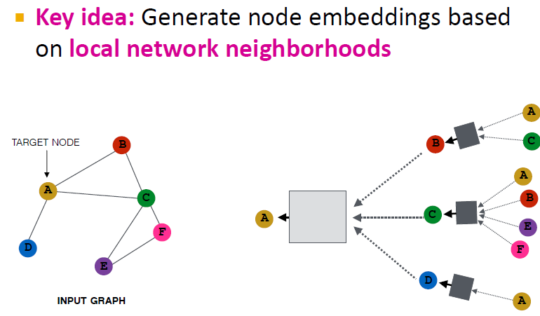
Idea – Aggregate Neighbors

Slide 22
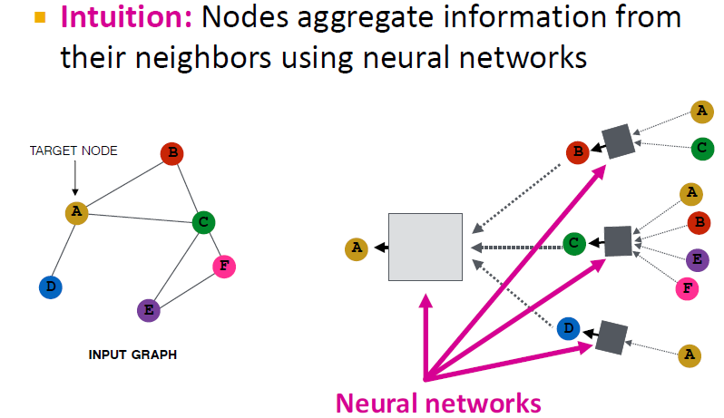
Idea – Aggregate Neighbors

Slide 23
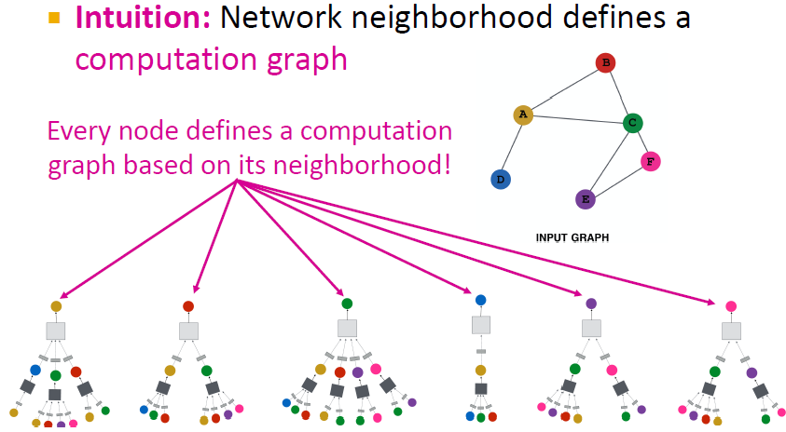
Key Idea – Aggregate Neighbors

Slide 24
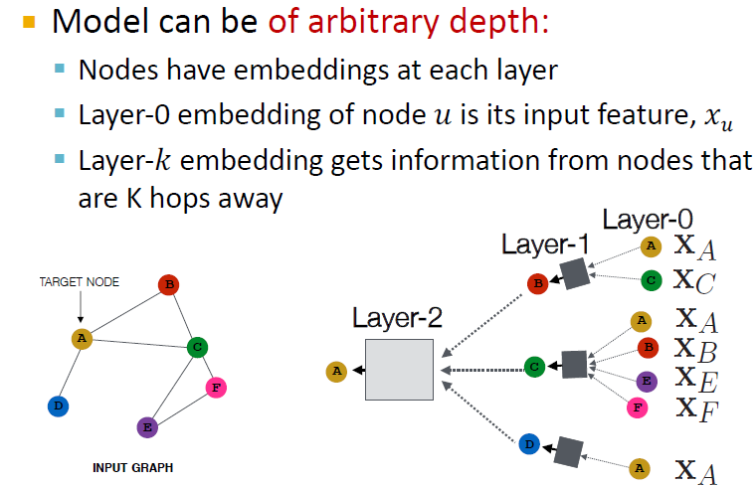
Deep Model – Many Layers

Slide 25
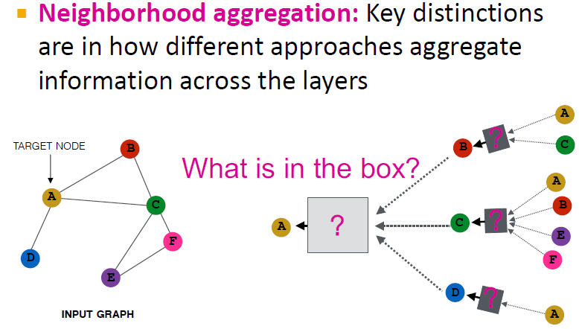
Neighborhood Aggregation

Slide 26
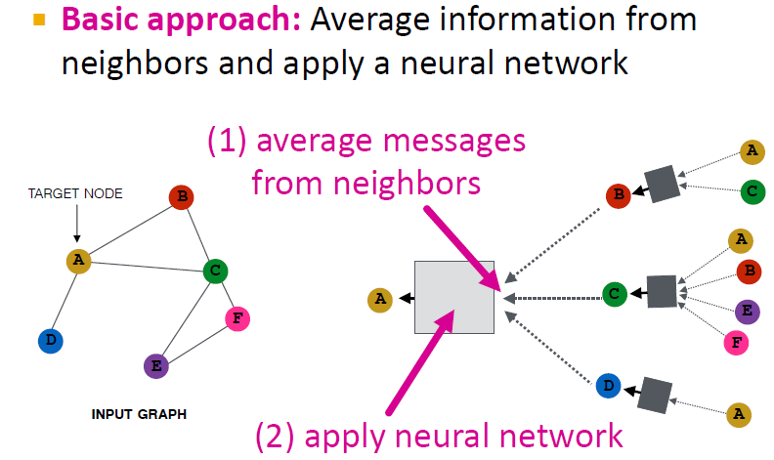
Neighborhood Aggregation

Slide 27
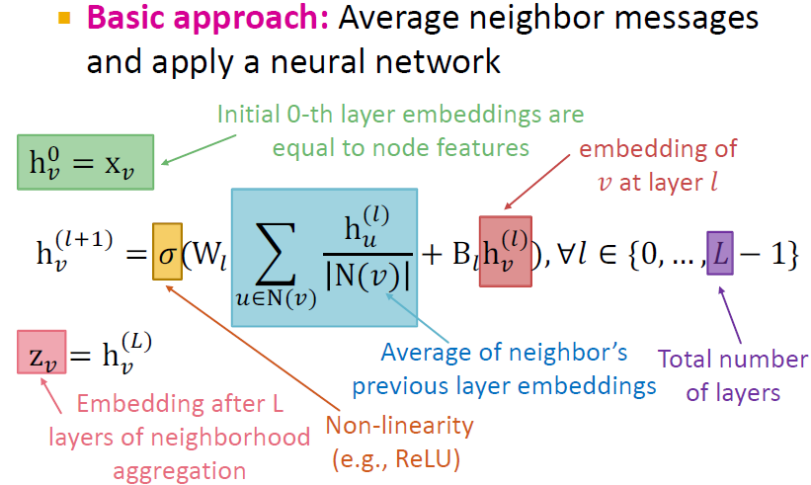
The maths behind the deep encoder

Slide 28
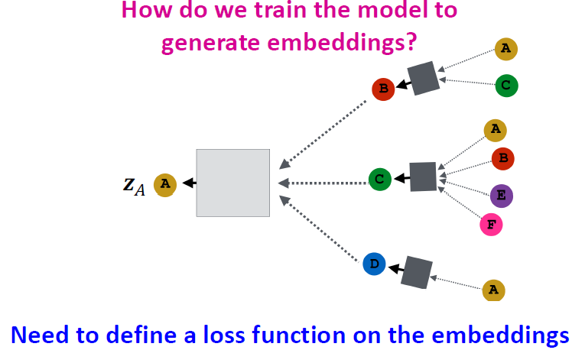
Training the model

Slide 29
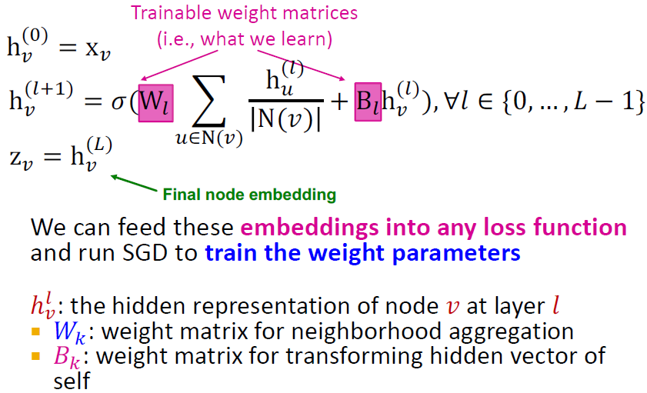
Model Parameters

Slide 30
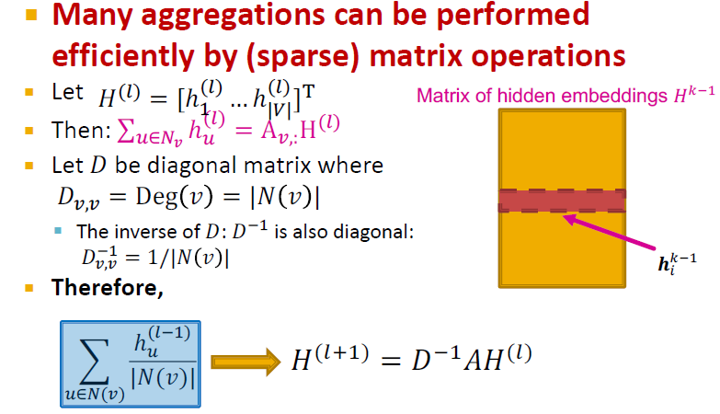
Matrix Formulation

Slide 31
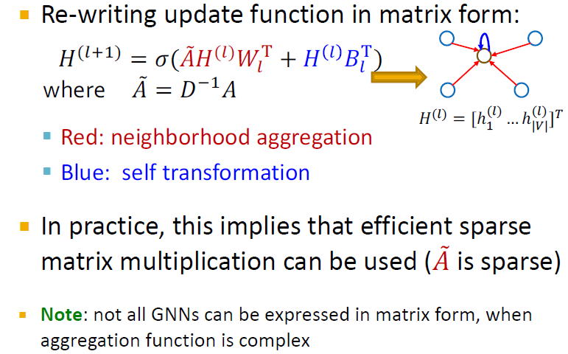
Matrix Formulation

Slide 32
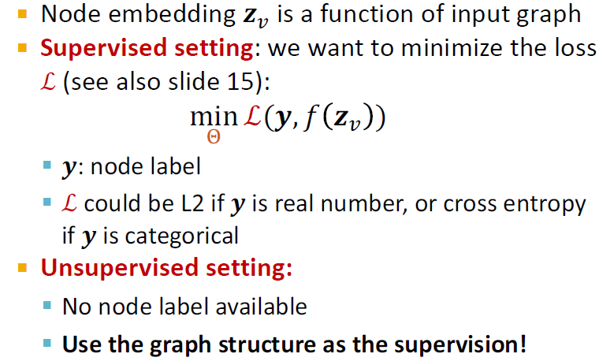
Training the GNN

Slide 33
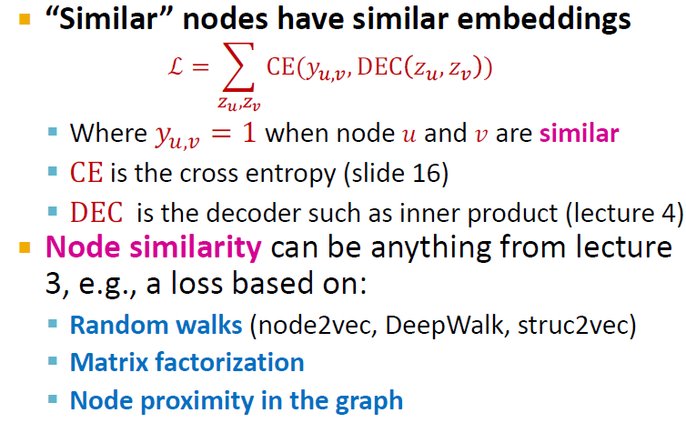
Unsupervised Training

Slide 34
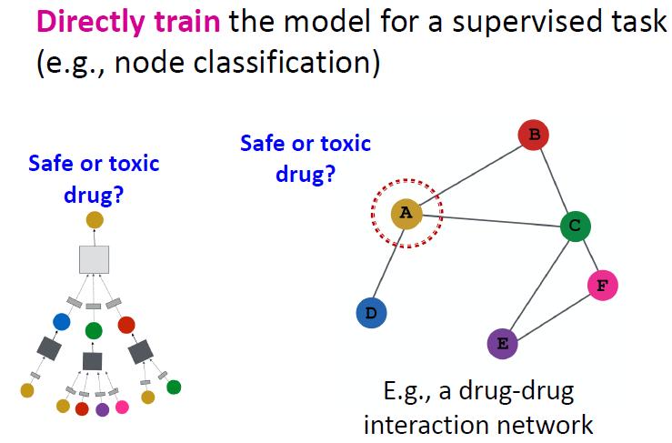
Supervised Training

Slide 35
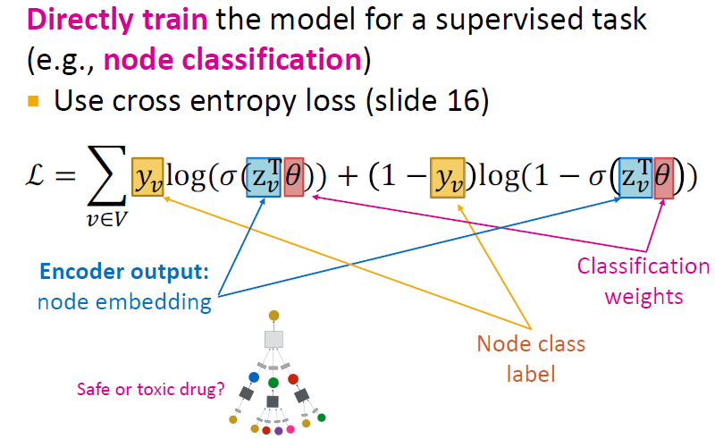
Supervised Training

Slide 36
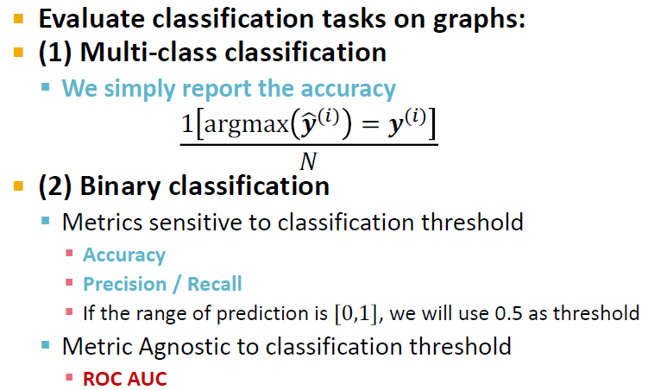
Evaluation Metrics: Classification

Slide 37
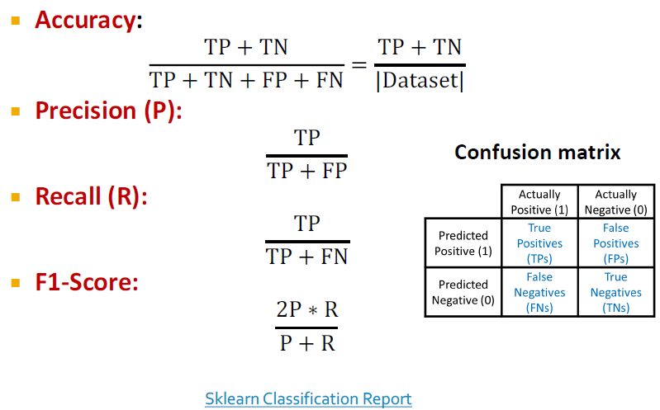
Metrics for Binary Classification

Slide 38
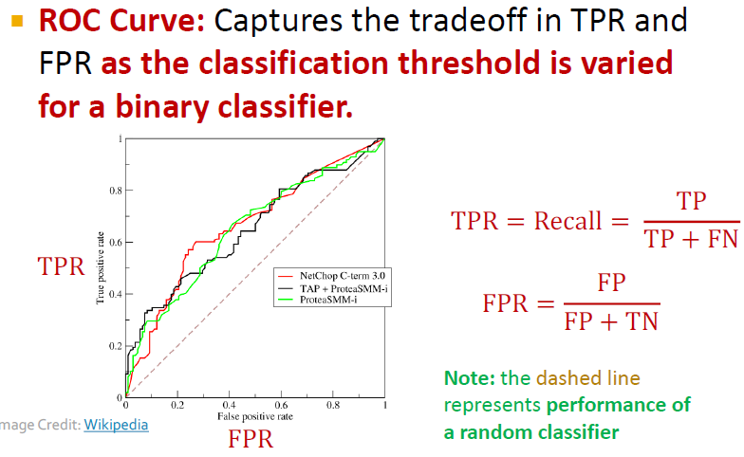
Evaluation Metrics

Slide 39
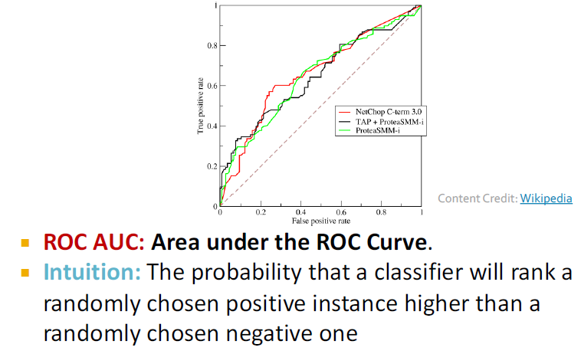
Evaluation Metrics

Slide 40
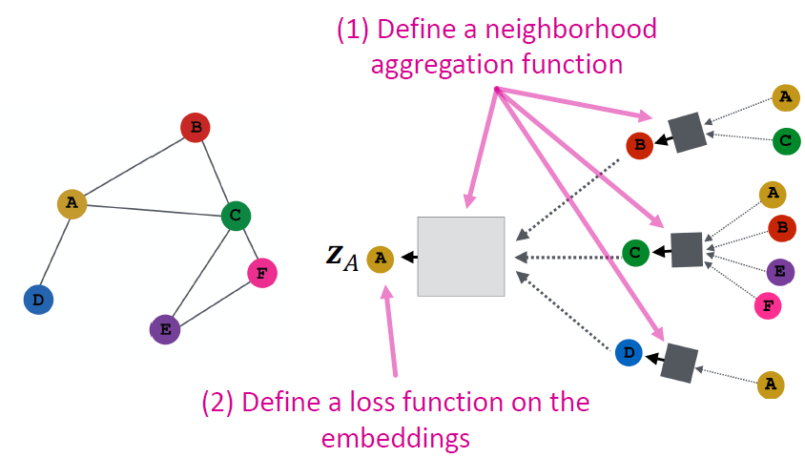
Model Design Overview

Slide 41
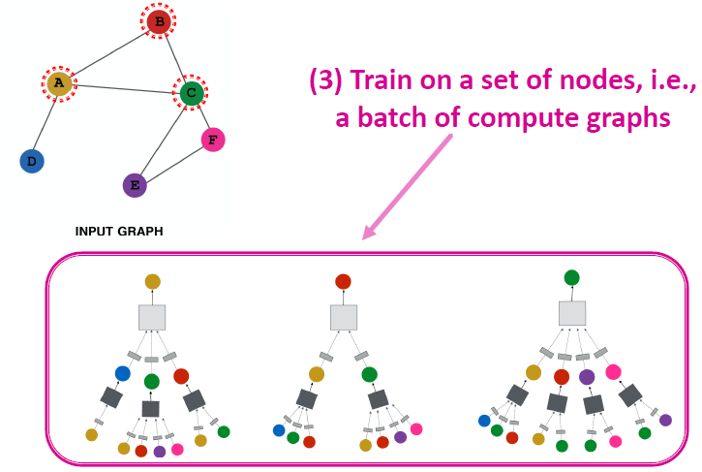
Model Design Overview

Slide 42
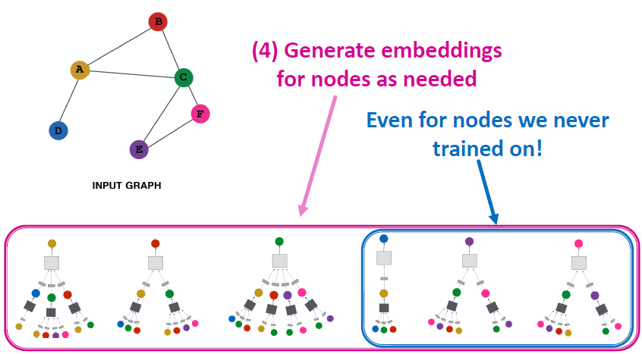
Model Design Overview

Slide 43
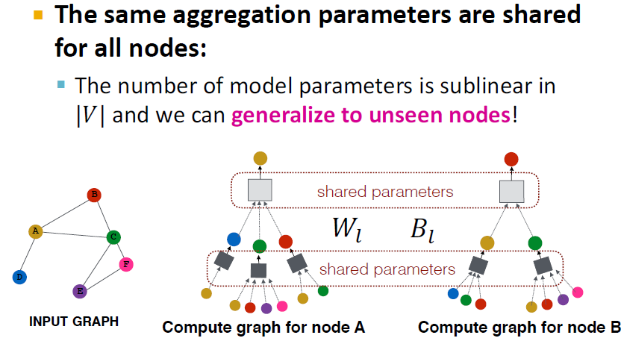
Inductive Capability

Slide 44
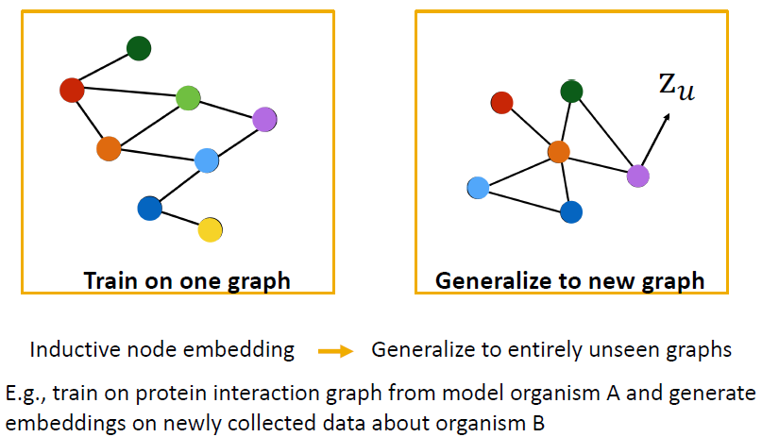
Inductive Capability on New Graphs

Slide 45
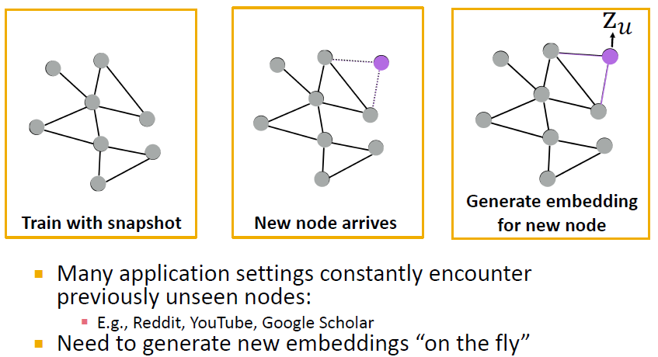
Inductive Capability on New Nodes

Slide 46
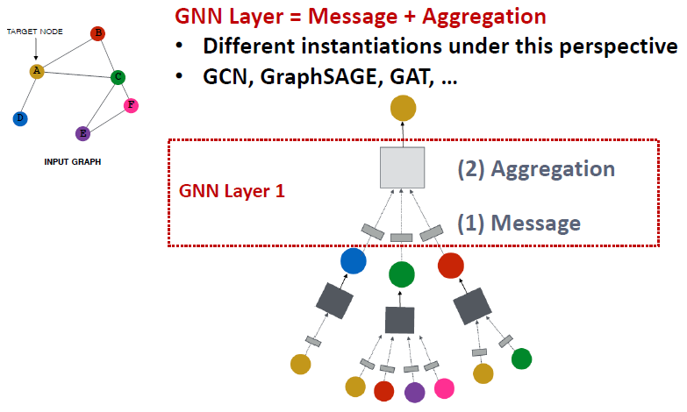
A Single GNN Layer

Slide 47
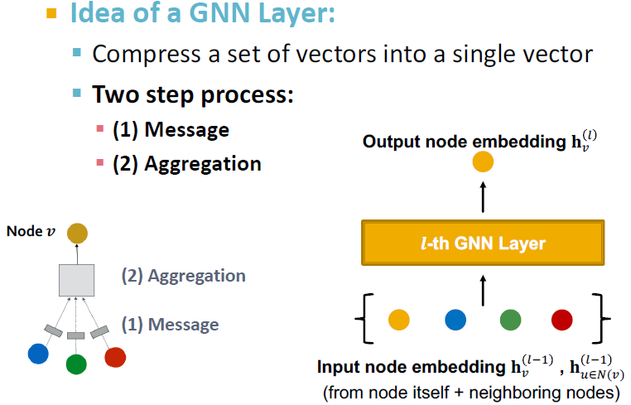
A Single GNN Layer

Slide 48
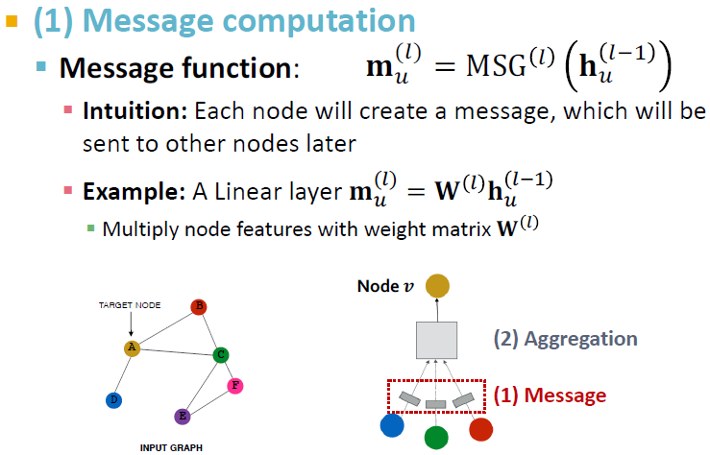
Message Computation

Slide 49
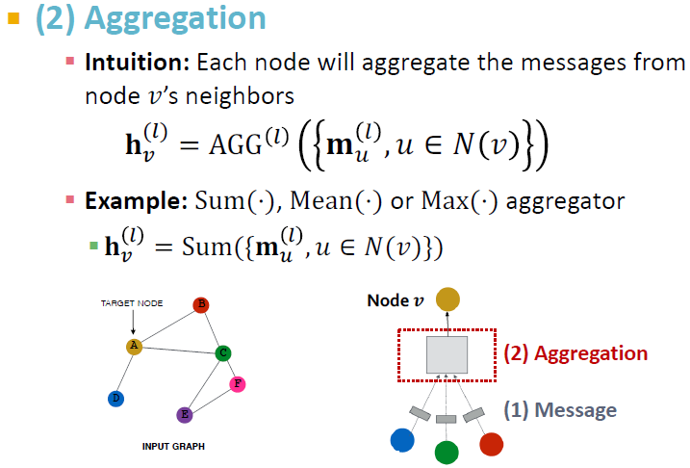
Message Aggregation

Slide 50
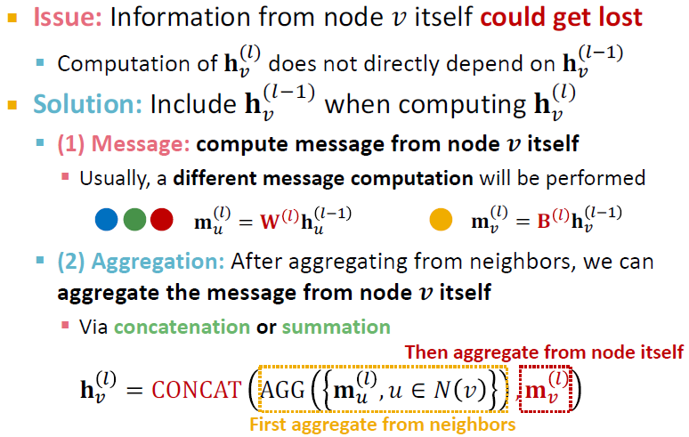
Message Aggregation Issue

Slide 51
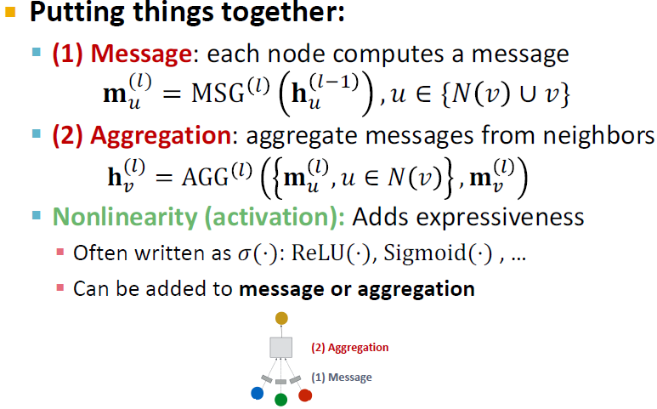
A Single GNN Layer

Slide 52
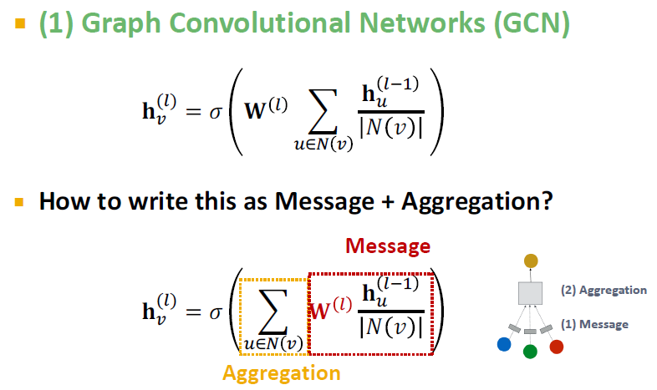
Different GNN layers

Slide 53

Different GNN Layers

Slide 54

Different GNN Layers: GraphSage

Slide 55

GraphSAGE Neighbor Aggregation

Slide 56

GraphSAGE L2 normalization

Slide 57

Graph Attention (GAT)

Slide 58

Graph Attention (GAT)

Slide 59

Graph Attention Networks

Slide 60

Attention Mechanism

Slide 61

Attention Mechanism

Slide 62

Attention Mechanism

Slide 63

Multihead Attention

Slide 64

Benefits of GAT

Slide 65

GAT Example Cora Citation Net

Slide 66

GNN Layers in practice

Slide 67

Stacking GNN layers

Slide 68

The over-smoothing problem

Slide 69

Receptive fields of GNNs

Slide 70

Receptive fields of GNNs

Slide 71

Mitigating Over-Smoothing Problem

Slide 72

Solution - 1

Slide 73

Solution - 2

Slide 74

Solution - 3

Slide 75
Scaling up GCNs
How to implement GCNs for large graphs

Slide 76

Problem with scale

Slide 77

Why it is hard

Slide 78

Methods

Slide 79

Neighbor Sampling

Slide 80

Issues

Slide 81

How to sample nodes?

Slide 82

Subgraph Sampling

Slide 83

Cluster GCN

Slide 84

Simplifying GCN

Slide 85

GCN (Mean Pool)

Slide 86

Simplifying GCN

